Slide 1
Digital Portfolio
STUDENT NAME: VARSHINE RS
REGISTER NO AND NMID: 2428K0411 & asbruaz2428k0411
DEPARTMENT: BSC CS (AI & DS)
COLLEGE: KPR COLLEGE OF ARTS SCIENCE AND RESEARCH/BHARATHIYAR UNIVERSITY

Slide 2
PROJECT TITLE
Knowledge Quest: A Quiz Application
An engaging platform that combines learning with entertainment.
Provides real-time feedback and score tracking for users.
Lightweight, user-friendly, and easy to expand with more questions.
Developed using Python to strengthen programming logic and problem-solving.
Supports replay functionality for repeated practice and self-assessment.
Can be extended into a GUI or web-based application for broader reach.

Slide 3


AGENDA
Problem Statement
Project Overview
End Users
Tools and Technologies
Portfolio design and Layout
Features and Functionality
Results and Screenshots
Conclusion
Github Link
3/21/2024 Annual Review

Slide 4

PROBLEM STATEMENT
Traditional quiz methods are static and less engaging.
Lack of interactive platforms for quick learning and assessment.
Need for a simple, user-friendly system to test knowledge in real-time.
Difficulty in tracking performance and progress using manual methods.

Slide 5

PROJECT OVERVIEW
A Quiz Game application that presents multiple-choice questions.
Users select answers, and the system instantly checks correctness.
Final score displayed at the end of the game.
Provides an engaging way to learn and self-test knowledge.
Lightweight design that can be easily deployed and accessed.

Slide 6

WHO ARE THE END USERS?
Students – to practice and test their subject knowledge.
Teachers/Trainers – to use as a teaching aid.
General Users – to play for fun and improve general knowledge.

Slide 7

TOOLS AND TECHNIQUES
Programming Language: Python
IDE/Editor: VS Code / PyCharm
Version Control: Git & GitHub
Optional: Tkinter (for GUI) / Web stack if web-based

Slide 8
POTFOLIO DESIGN AND LAYOUT
Intro Screen – Game title and start option.
Quiz Screen – Displays questions with multiple choices.
Answer Check – Immediate right/wrong feedback.
Scoreboard – Shows total correct answers at the end.
Replay Option – Restart quiz for another attempt.
8

Slide 9
FEATURES AND FUNCTIONALITY
Interactive multiple-choice quiz.
Score calculation and result display.
User-friendly interface (console/GUI).
Replay functionality for repeated play.
Easy scalability – new questions can be added.
Error handling for invalid inputs.
Simple code structure for easy maintenance and future upgrades.

Slide 10

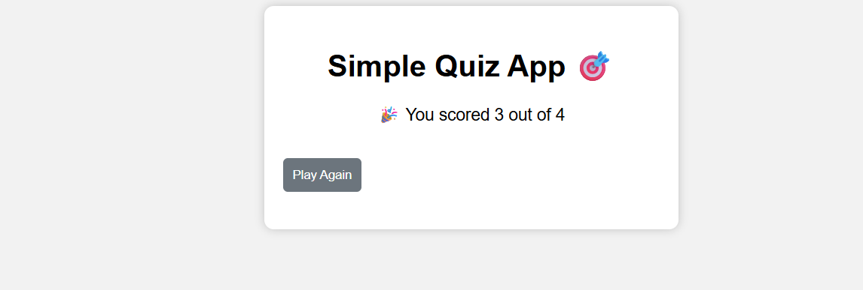
RESULTS AND SCREENSHOTS
Successfully runs without errors.
Displays accurate scoring.
Engages users with instant feedback.
3/21/2024 Annual Review
10

Slide 11
CONCLUSION
The Quiz Game provides a fun and educational platform.
Helps improve programming knowledge and logic.
Can be expanded into a complete learning tool with timer, categories, and leaderboard.
Offers a balance between entertainment and educational value.
11

